Slide 1

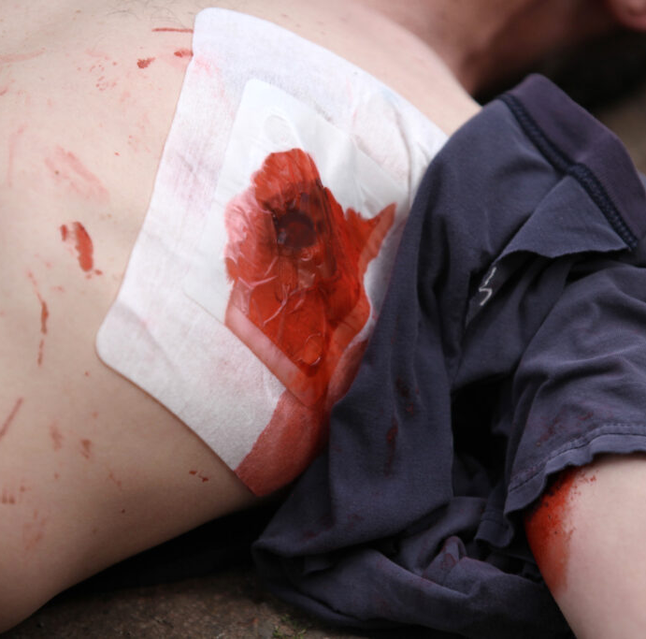
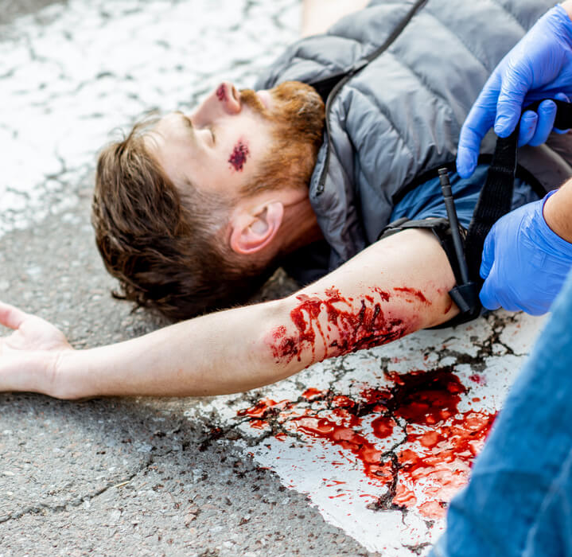
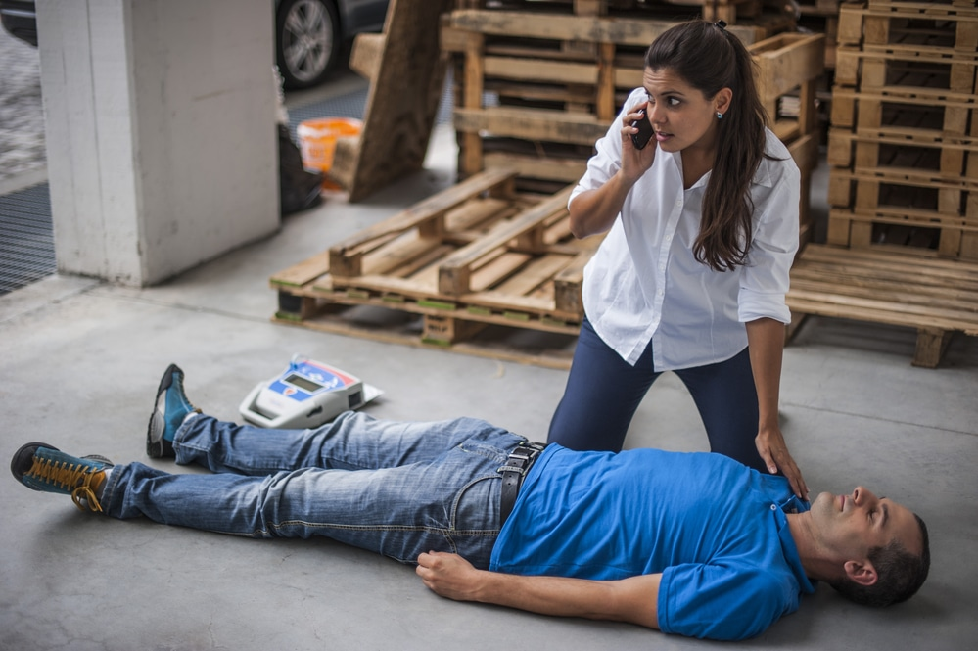
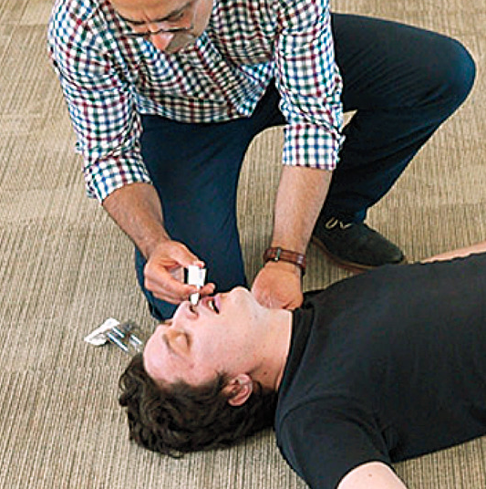
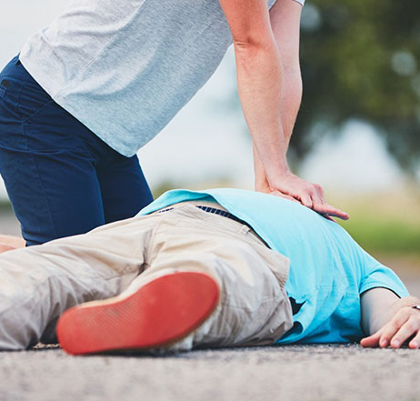

FREE Community Responder Training 4-hour Course
Dates: November 23
Time: 8:00 AM to 12:00 PM
Location: DeWitt Clinton Masonic Lodge No. 141
1800 Hawk Town Road, Maidens, VA 23102
Register: https://ctcce.vcu.edu/goochland/
Use Registration Code: Lodge141
Course includes:
Activating the 911 system
Hands-only CPR and AED
Administering Naloxone
Choking
Responding to life-threatening bleeding

